Slide 1
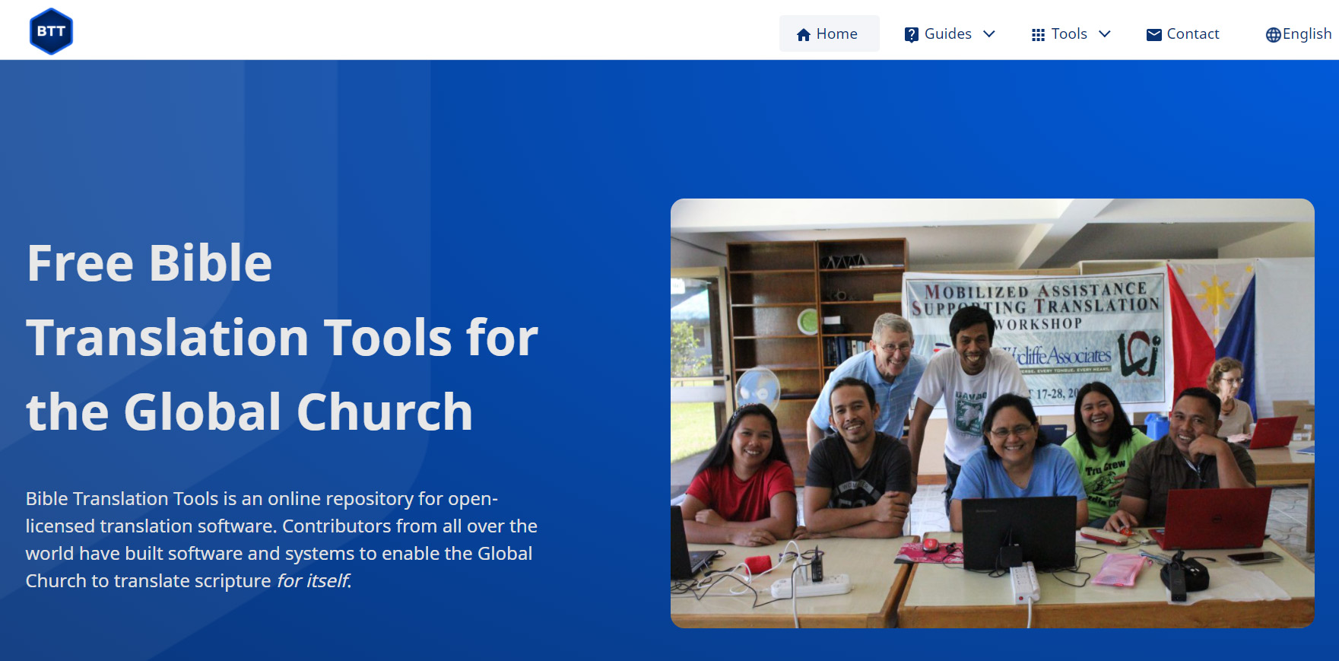
Technical Tools: BTT Writer
Topic 7 – Session 1

Slide 2
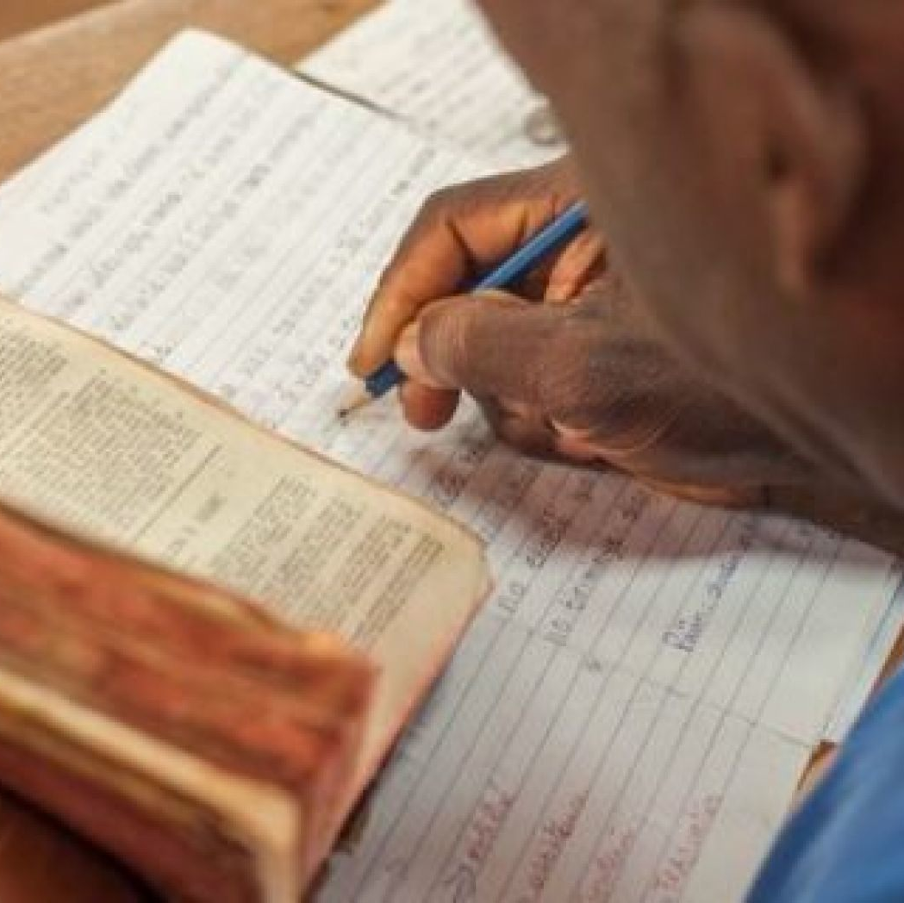

Written Translation
1
2

Slide 3




BTT Writer Advantages
8 Steps of MAST
Easy Upload
FREE

Slide 4


Additional Free Programs

Slide 5
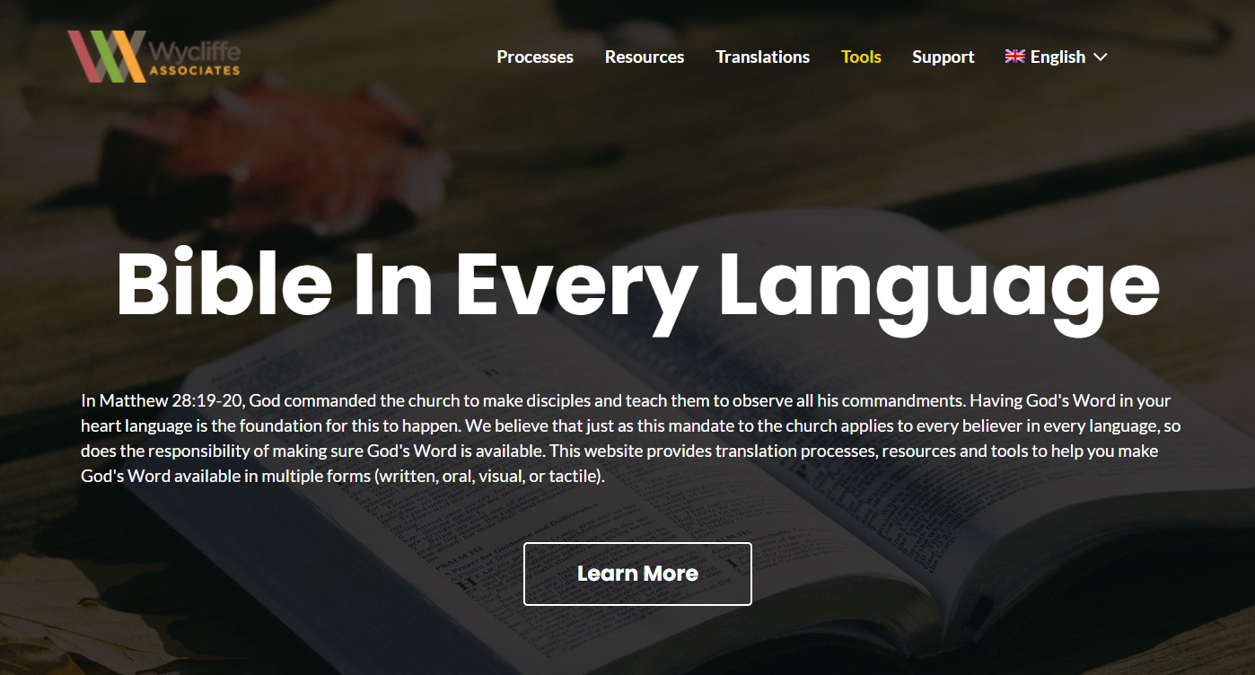

Download Free Tools:
https://bibleineverylanguage.org/
Need help? TS@WycliffeAssociates.org

Slide 6


